Slide 1
Project 6
beta
Group 4

Slide 2
Data Model
application_record.rb
current.rb
event.rb
feedback.rb
student.rb

Slide 3
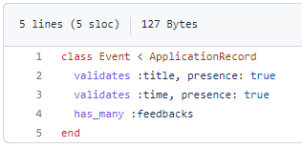
Data Model: event.rb

Slide 4
Event.rb
Gives the title of the presentation, and the time that it takes place.
Allows for multiple feedback attributes for each presentation to allow for peer feedback.

Slide 5
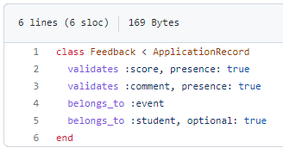
Data Model: feedback.rb

Slide 6
Feedback.rb
Allows scores to be given to each presentation.
Each reviewer can leave additional comments as well.
Connects the feedback to the presentation event.
Each feedback is associated with a student id, so that it may be used for later feedback display

Slide 7
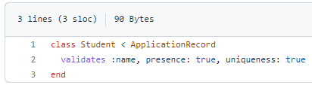
Data Model: student.rb

Slide 8
Student.rb
Each student name is made and must be unique to be assigned for presentations.

Slide 9
Gems Used
Sprockets-rails
Original asset pipeline for Rails
Sqlite3
Used as the database for records
Puma
Used for the web server
Importmap-rails
Javascript with ESM import maps
Turbo-rails
Page accelerator
Stimulus rails
Javascript framework
Jbuilder
Builds JSON API’s
Tzinfo-data
Windows does not have zoneinfo files, utilized as a workaround
Bootsnap
Reduces boot times through caching

Slide 10

Things of Note

Slide 11
Sessions
Allow for single point of control for current student
Useful for interacting with different pages
Displaying different information based on current_student
Auto-input current_student on feedback forms
Ability to ‘login’
Login page runs session#create and with session helpers, stores the student in current_student

Slide 12

Next Steps

Slide 13
Next Steps
Proper authentication
Password implementation with Bcrypt
Schedule revamp
Show whole month rather than one day
Separate Admin class
Not just a privileged student
Completely different dashboard
Slides integration

Slide 14

Questions?

Slide 15

Thank you!

